Slide 1

Men in Yellow Hats Monkey MedSensor
By:
Adam Carter, Mike Rzepka, Jim Dowling,
and Lakshmana Dheeraj Polisetty

Slide 2
IMB Use Case #6
Based off of the real time monitoring use case of monitoring patient data.
Created a system that tracks both live data and historical data from that live data.
Live data is filtered to be only the individual instance of the current data (to prevent data bloat), and the historical data is maintained as a separate stream send to a separate table by a configurable threshold.
Created a Simulated Device Launcher to be able to launch multiple sets of devices representing multiple patients.

Slide 3
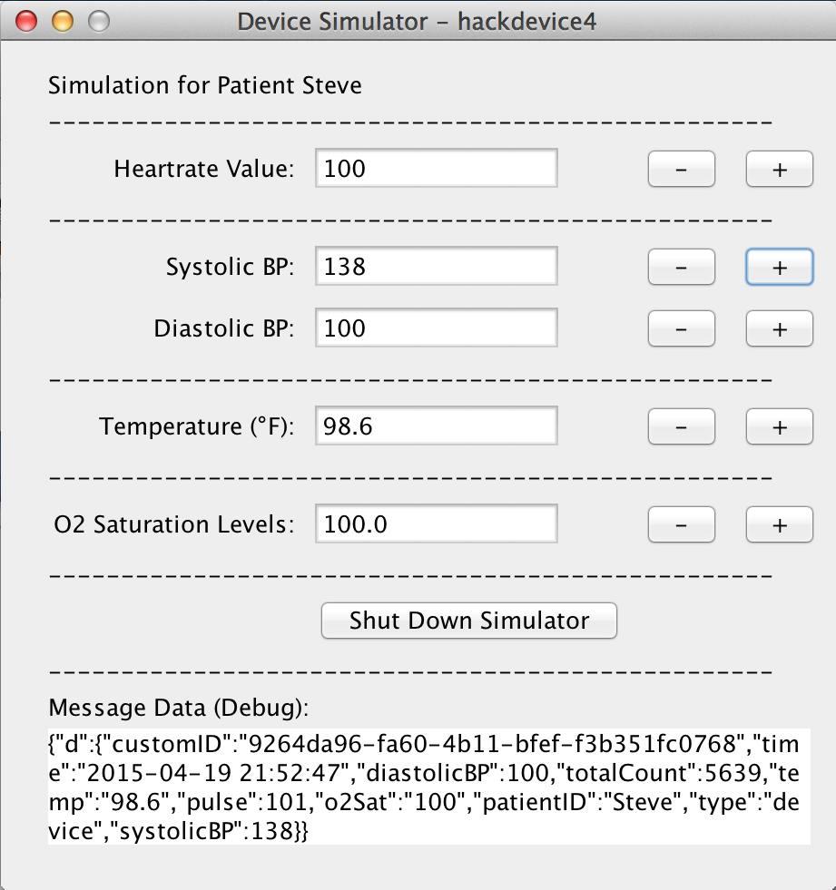
MQTT Device Simulator
Create a MQTT Device Simulator to simulate multiple devices.
Can adjust any of the represented fields which will send updates from the device.
Added a random variability around pulse to display regular variance in the data.

Slide 4
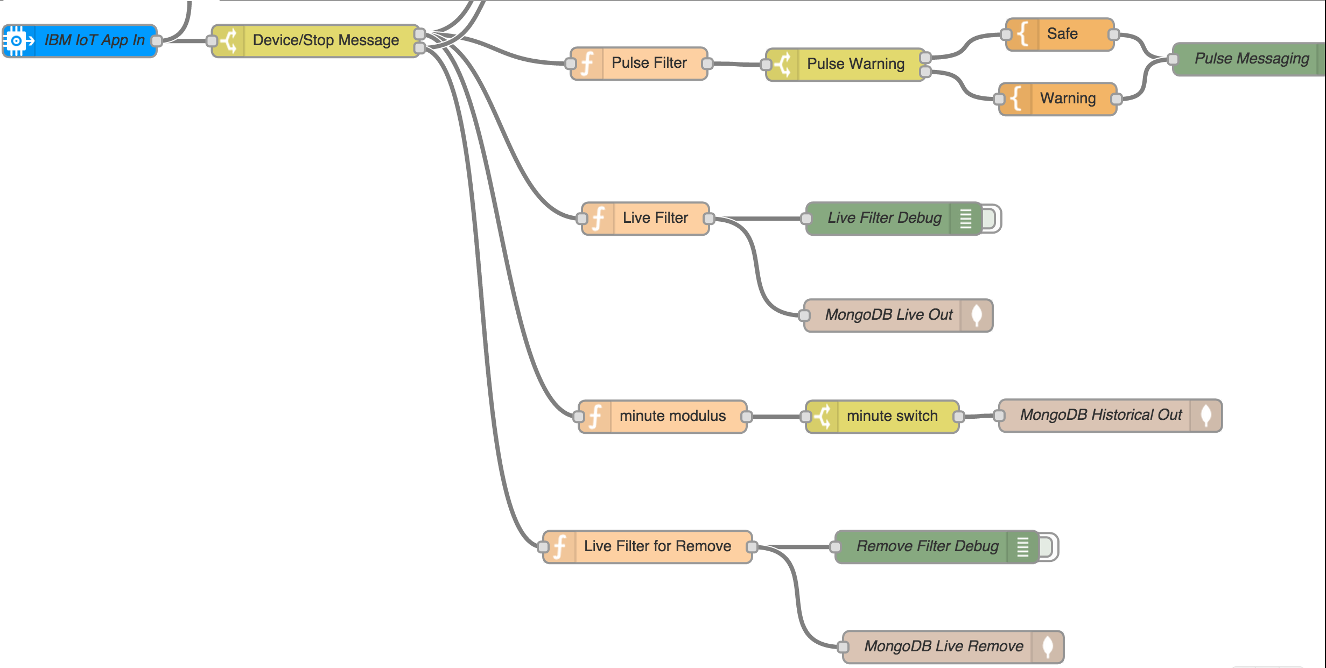
Node Red Flows

Slide 5
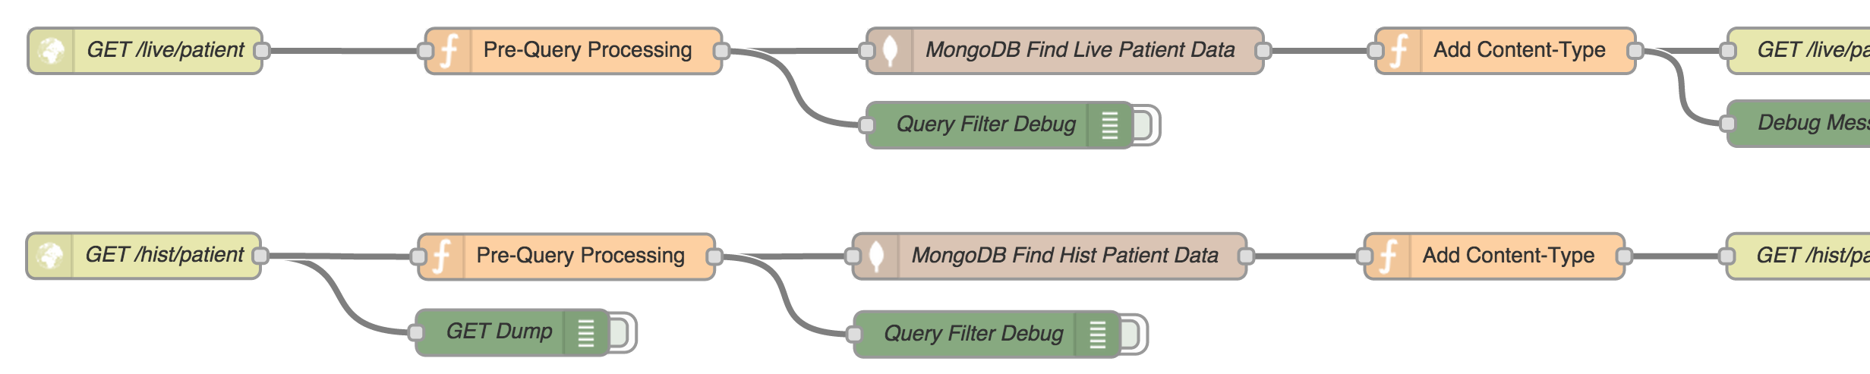
Node Red Flows Cont.
Two REST End Point Flows added to be able to view the data from the MongoDB instance.
Can pull both the currently active live data, as well as the historical data based on a set of criteria (Patient, Time Range, and Offset from UTC).

Slide 6
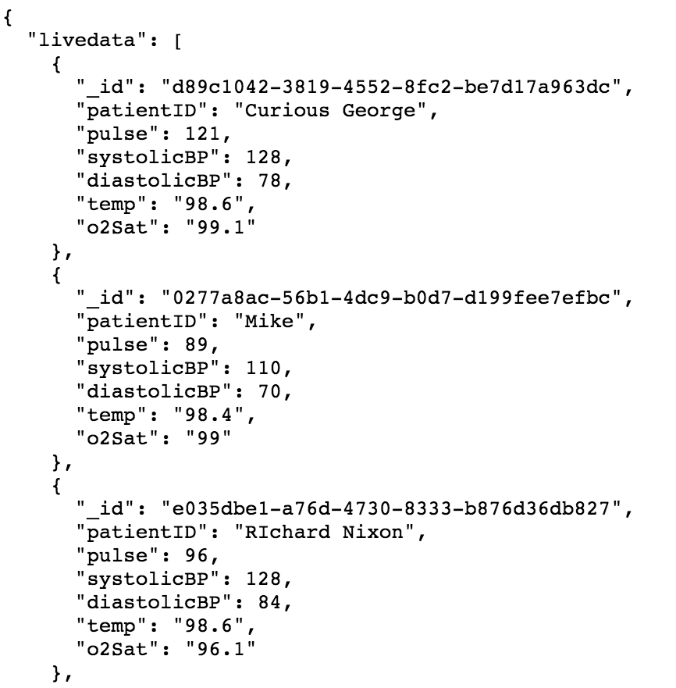
Live REST Data
Able to query against the live MongoDB table to see the currently active data entries in the system.
Can differentiate between a device that stops submitting data (the last active state), and a device currently sending data.

Slide 7
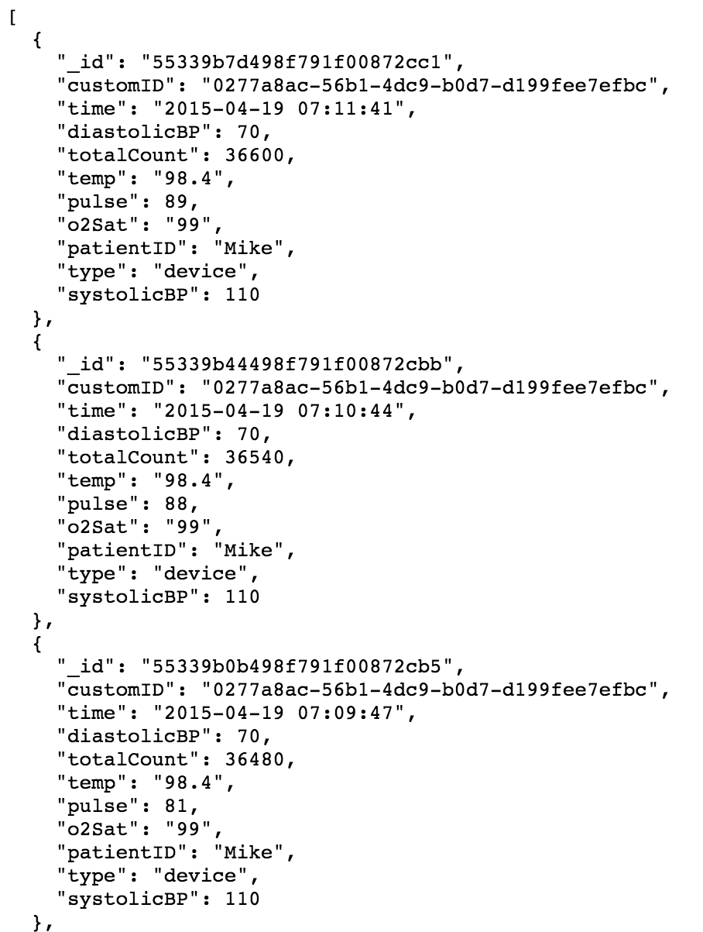
Historical REST Data
Historical data includes entry for each interval.
Uses a unique message ID, as well as timestamp at that point in time.
Can query based on a specific person and a time range for that person.

Slide 8
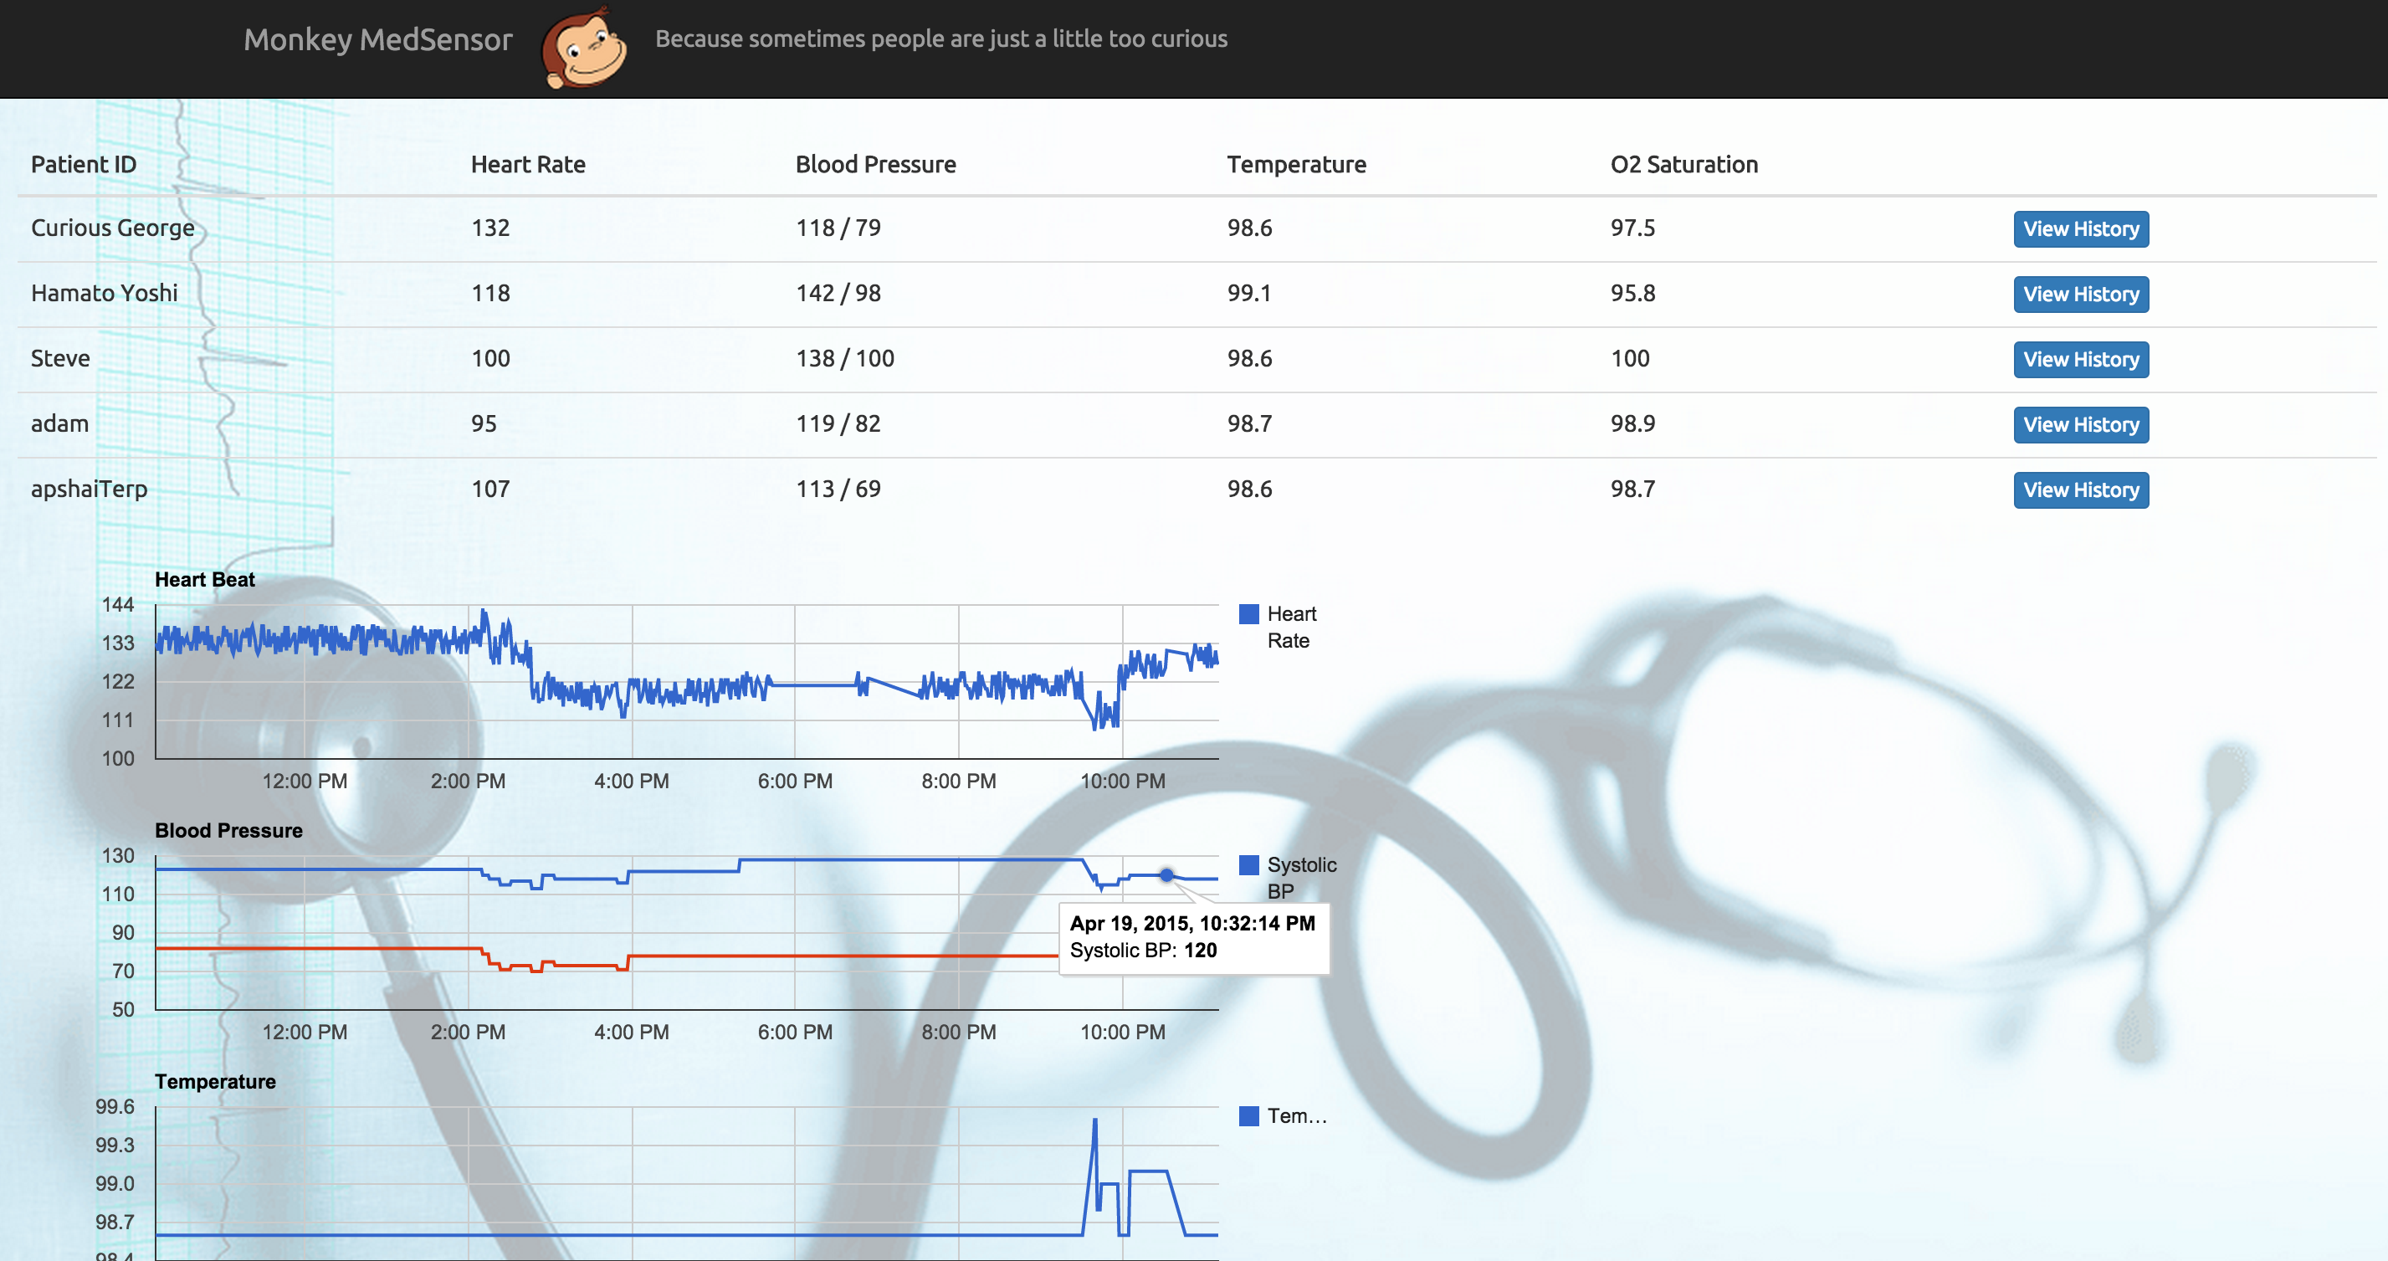
Monkey Dashboard

Slide 9

Demo

Slide 10

Questions?

